Slide 1
On the Oriented Chromatic Number of Halin Graphs
Information Processing Letters 98(2006) 247-252
Mohammad Hosseini Dolama, Éric Sopena
Presenter: Jun-Shong Lin
Date: June 22, 2006

Slide 2
Abstract
An oriented k-coloring of an oriented graph G is a mapping c :V (G)→{1, 2, . . . , k} such that (i) if xy ∈ E(G) then c(x) = c(y) and (ii) if xy, zt ∈ E(G) then c(x) = c(t)⇒c(y) ≠c(z). The oriented chromatic number of an oriented graph G is defined as the smallest k such that G admits an oriented k-coloring. We prove in this paper that every Halin graph has oriented chromatic number at most 9, improving a previous bound proposed by Vignal.

Slide 3

Introduction
An oriented k-coloring of an oriented graph:
x
y
V (H_{c}) = {c(x) | x ∈ V (G)}
E(H_{c}) = {c(x)c(y) | xy ∈ E(G)}.
G
Homomorphism
H_{c}
The minimum
number of vertices in an oriented graph H_{c}.
The smallest k such that G admits
an oriented k-coloring.

Slide 4
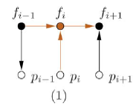
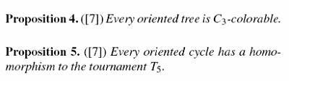
Halin Graphs
For every oriented Halin graph H,χ(H) ≤9.

Slide 5

Halin Graphs
Case 1:n≤6
f₁
f₂
C₃
……………………
y₁
y₂
y₃
y₄
y₅
y₆
f₆
f₃
G
f₅
f₄
So, χ(H) ≤ |G| ≤ 9.
H

Slide 6

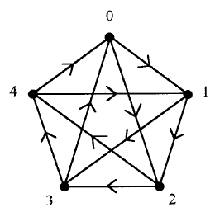

Halin graphs
Case 2:n≥7
f₁
f_{n}
f₂
C₃
f₃
G:
H
T₅
χ(H) ≤ |G| = 8.

Slide 7
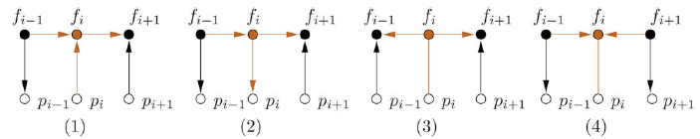
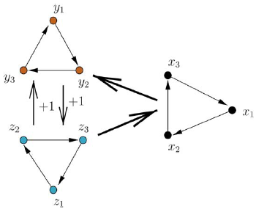

Halin graphs
(b) H contains one of the configurations.
Find f_{i}
f₁
f_{n}
f₂
f₃
f_{i}
p_{i}
f_{i}
H
G₉

Slide 8


Halin Graphs
f₃
f₁
f₂
G₉
i=3,p₃f₃∈V(H)
f₈
f₃
f₄
f₇
f₆
f₅
H
p₃

Slide 9
Halin Graphs
f₃
Add y₁z₁
Add y₃z₃
f₁
f₂
f₃
i=3,p₃f₃∈V(H)
f₃
f₈
f₃
f₄
f₇
f₅
f₂
G₉
f₆
f₂
H
f₄
f₂

Slide 10


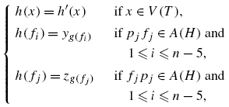
Halin Graphs
f₁
f₁
f_{n-1}
f_{n-3}
f_{n-1}
f_{n-5}
f₁
f_{n}
f₂
f₃
f_{n-2}
f_{n}
G₉
H
Homomorphism
G₉ +z₁y₁
f_{n-4}
f_{n}
H
H
Homomorphism
G₉ +{z₁y₁,z₂y₂ }

Slide 11



Halin Graphs
i=1
f₂
f₁
f_{n}
f₂
f₃
H

Slide 12
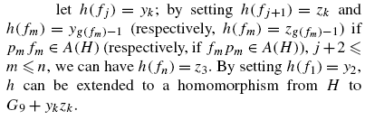
Halin Graphs
f₂
f₁
f₁
f_{n}
f₁
f₂
H
Homomorphism
G₉
f_{n}
f_{n}
H
Homomorphism
G₉+y₂z₂
f_{n},find j
f_{j+1}
f_{j-1}
f_{j}
f_{j+1}
f_{j}
f_{j+1}
f_{j}

Slide 13



Halin Graphs
f₁
H
Homomorphism
G₉
f₂
f₁
H
Homomorphism
G₉+y₂z₂
f_{n}
f₁
f₂
f_{r-1}
f_{n},find j
f_{n}
f_{n}
f_{r}
f_{j+1}
f_{j-1}
f_{j}
f_{j}
f_{j+1}
f_{j}
f_{j+1}
f_{j}

Slide 14
Halin Graphs
f₂
f₁
f₁
f_{n}
f₁
f₂
H
Homomorphism
G₉
f_{n}
H
Homomorphism
G₉+y₂z₂
f_{n}
f_{n},find j
f_{j+1}
f_{j-1}
f_{j}
f_{j+1}
f_{j}
case 2(d)(iii)
f_{j+1}
f_{j}

Slide 15
Halin Graphs
We thus found in all cases a homomorphism from H to some oriented graph with at most 9 vertices. Thus,χ(H) ≤ 9.

Slide 16

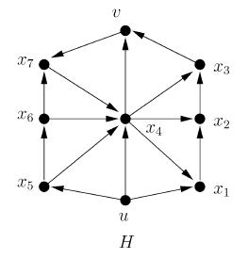
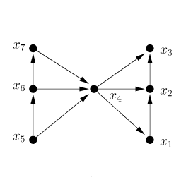
Halin Graphs
1
3
7
So, we have k≥7..
6
2
4
5
1
7
We get a contradiction and
thus k ≥ 8.

